Slide 1

CRIME AND TRANSPORTATION NETWORK ANALYSIS
PRESENTED BY – GROUP 44
SAMAIKHYA CHOPPADANDI 2145011
DIVYA SAI DOPPALAPUDI 2153373
TIRUMALESH NADELLA 2153438
NABIL MARTINEZ 1814918

Slide 2
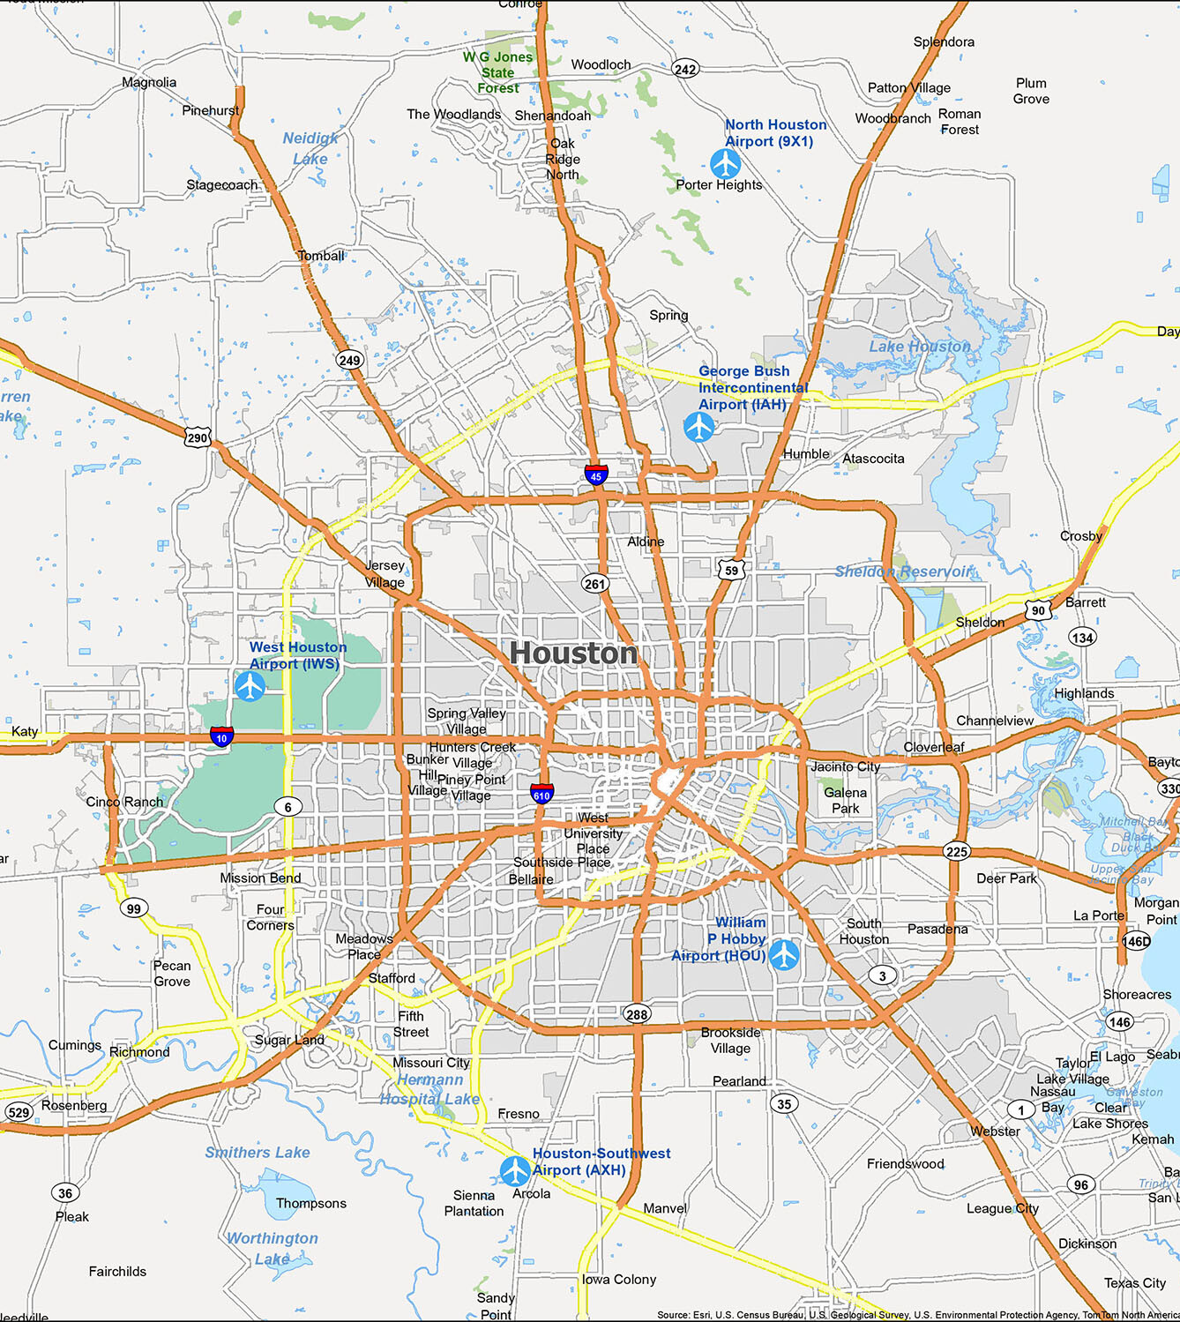
INTRODUCTION
Houston is the largest city in Texas and has a diverse population.
Unfortunately, like many large cities, Houston has struggled with high crime rates.
In recent years, the city has seen a decrease in overall crime, but certain types of crime, such as motor vehicle thefts, Driving under influence, have remained relatively high.
The transportation infrastructure of the city can have huge impact on the crimes in the city.
This project focus on exploring the relationship between different types of crime and transportation network in Houston.

Slide 3
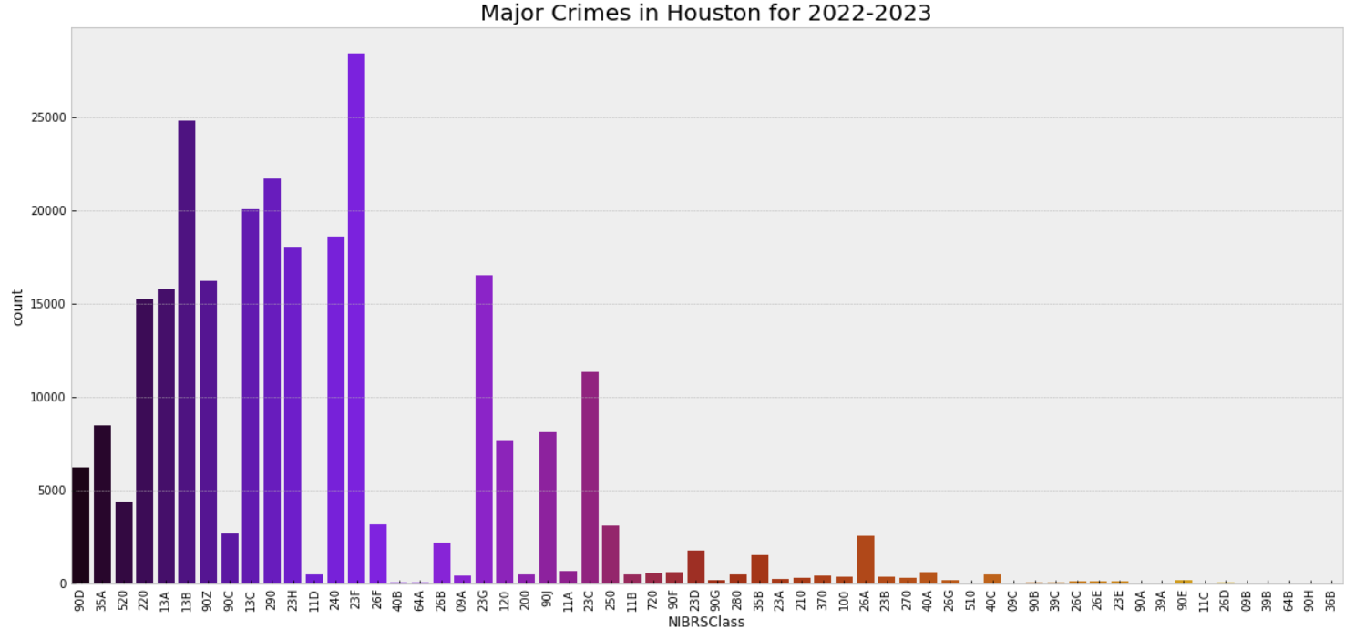
DATASET
The dataset consists of reports written by the Houston Police Department which has close to 1 million records along with the locations.
The dataset also includes all the public amenities in the Houston city with their locations.
These datasets are used to analyze the relationship between difference crimes and transportation facilities.

Slide 4
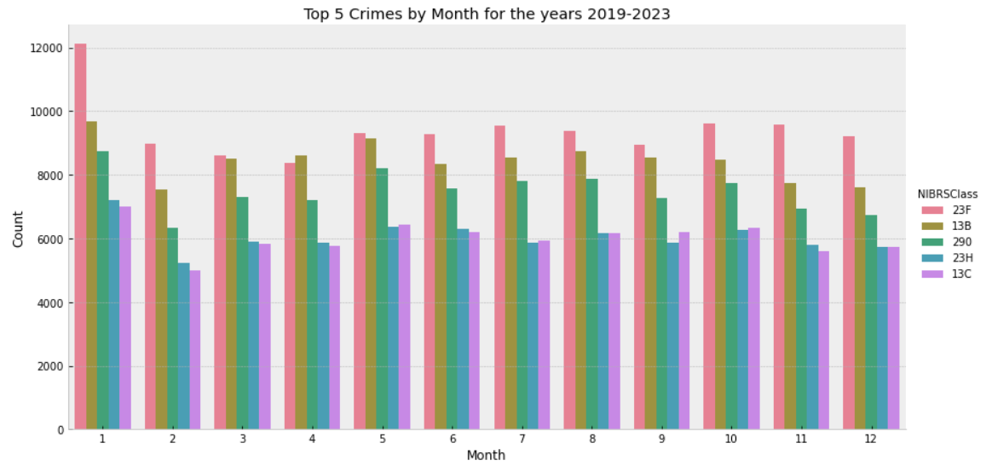
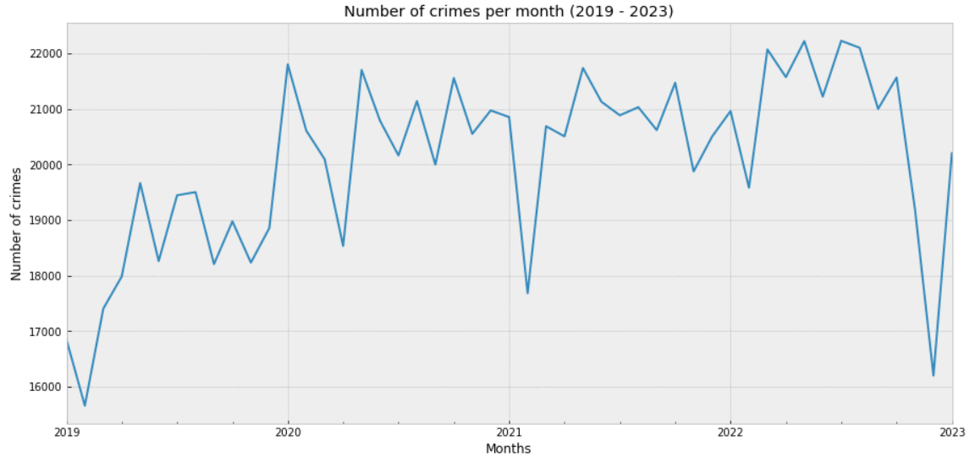
DATA ANALYSIS
The visualization represents the highest number of crimes observed each month.
23F: Theft from motor vehicle 12B: Simple assault
290: Destruction, damage, vandalism 23H: All other larceny
13C: Intimidation
The visualization represents the rolling number of crimes observed each month over the 5 years.
We observe sharp drop in the month of December in the year 2022.

Slide 5
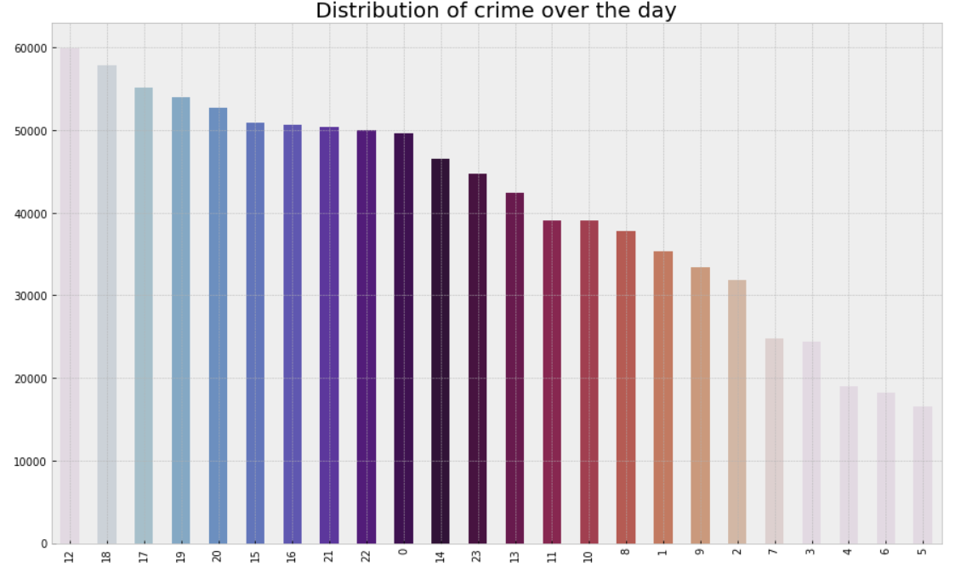
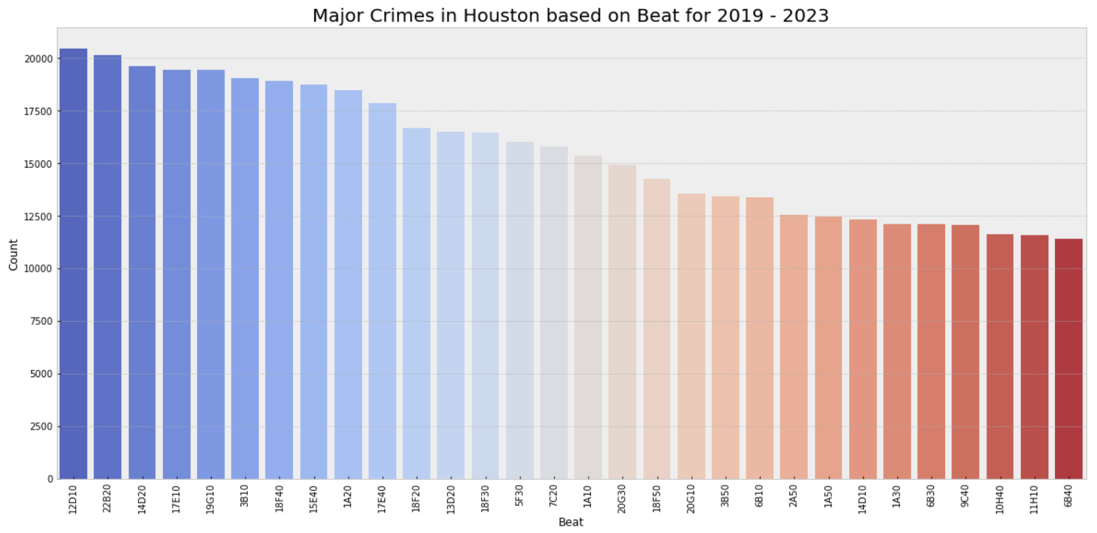
DATA ANALYSIS
The visualization represents the distribution of crime based on hour over the day.
We observe that at midday, we observe the highest number of crimes.
The most occurring crime, motor vehicle theft can be said that it is mostly observed at the midday.
The visualization represents the distribution of crimes over the beats.
The beats represent the areas divided by the Houston police department to patrol and monitor the areas.

Slide 6
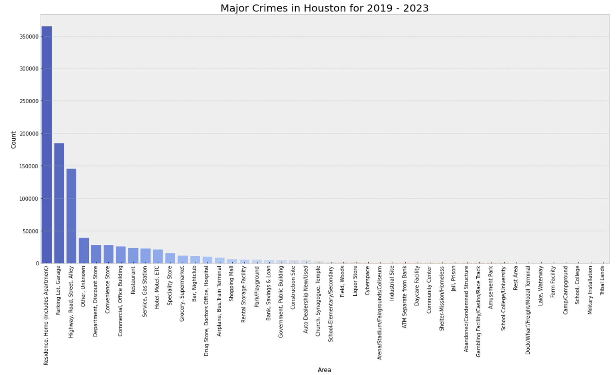
DATA ANALYSIS
The above visualization shows the distribution of crime on the premises with residential areas, parking lots and highways observing majority of crimes.

Slide 7
CLUSTERING OF DATA
PIVOT TABLE
Pivot tables are a data summarization tool used to quickly summarize and analyze large datasets by creating summary tables that organize and summarize data based on different categories and aggregations.
AGGLOMERATIVE CLUSTERING
Agglomerative clustering is a type of hierarchical clustering algorithm used in machine learning and data analysis.
It is a bottom-up approach where the algorithm starts by treating each observation as a separate cluster, and then successively merges the closest pairs of clusters together based on a specified distance metric.
In agglomerative clustering, the distance between clusters is determined by a linkage function, which measures the distance between the points in each cluster.
While agglomerative clustering and pivot tables are used for different purposes, they can be used together to gain insights into complex datasets.

Slide 8
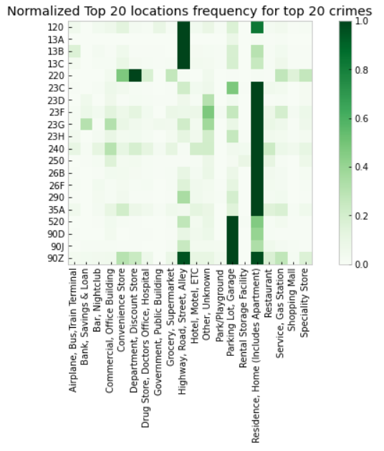
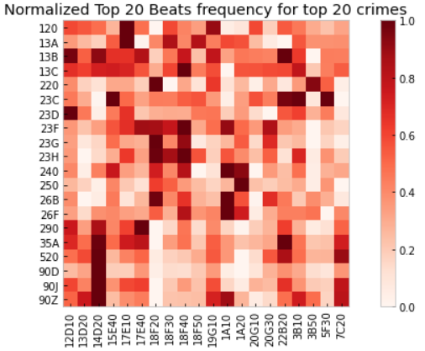
CLUSTERING OF DATA
From the above visualization, we cannot infer much on the relationship between crimes and the beats.
By considering another parameter “Premise”, we can get a better view of which areas are affected the most.

Slide 9
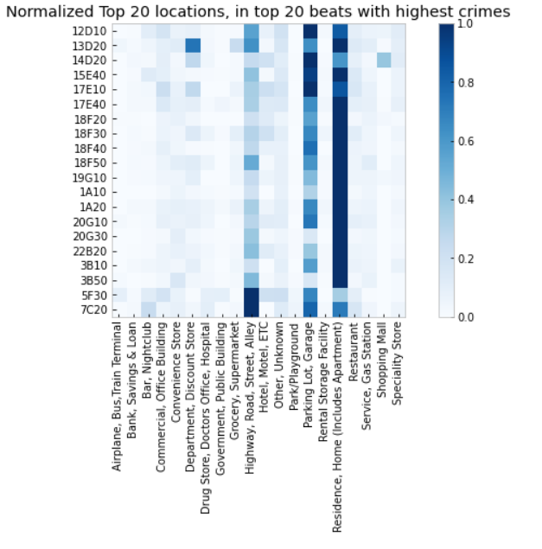
CLUSTERING OF DATA
This visualization gives a much more detailed relationship on the premise and the geographic beats
We can infer that the residential areas are the most prone zones, followed by parking lots
The highest type of crime we observed is 23F, “theft from motor vehicles” is prominently in all the beats and majorly impacting Residential places.
Since, our concentration is on transportation network nodes, and the most observed type of crime is 23F, we will focus on parking lots and garage as we can gather location coordinates and visualize clearly.

Slide 10
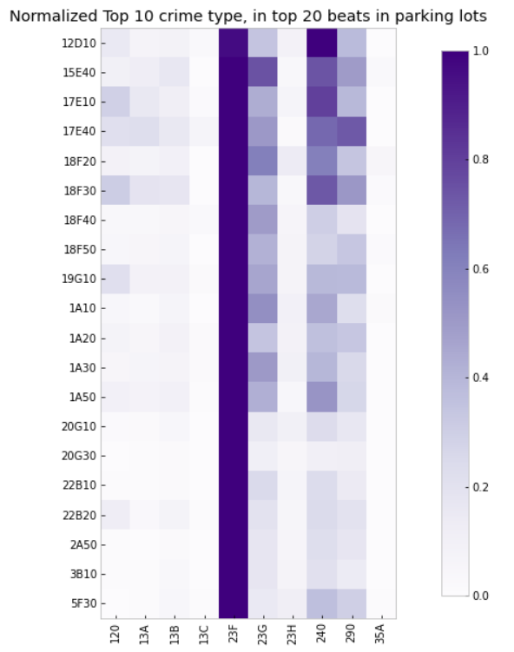
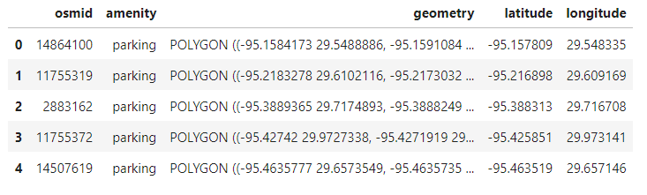
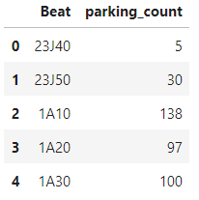
TRANSPORTATION NODE ANALYSIS
The dataset on real-time parking lots have been extracted from osmx.
The extracted nodes are then segregated into beats based on the polygon coordinates of the beats.
The crime data set is filtered for parking lot, garage premises.
Both the crime data and the extracted nodes are grouped by the beats.

Slide 11
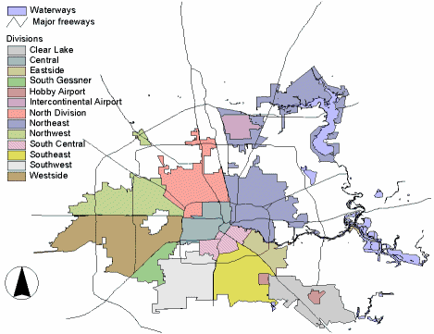
GEO SPATIAL ANALYSIS
Geospatial analysis is the process of using data that has a geographic or spatial component to understand patterns, relationships, and trends.
This type of analysis involves analyzing data that has a location component, such as latitude and longitude coordinates, to gain insights and inform decision-making.
With the help of Open Street Map view we are analyzing the location components, applying spatial statistics on the crime data based on zip code, police beats and premise.
Analyzed the crime data based on Houston Police beats, represented as shown in the figure.

Slide 12
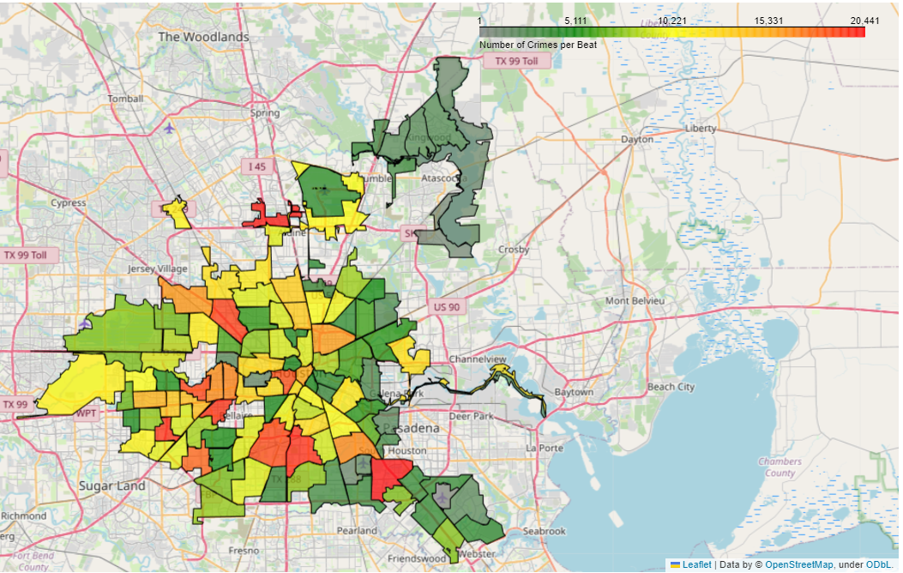
GEO SPATIAL ANALYSIS
The geo spatial map represents the distribution of all types of crime over the Houston map based on beats.
The beats in red color represents the highest risk zones and the grey color represents the safest zones.
The count of each beat is presented in the data analysis part.

Slide 13
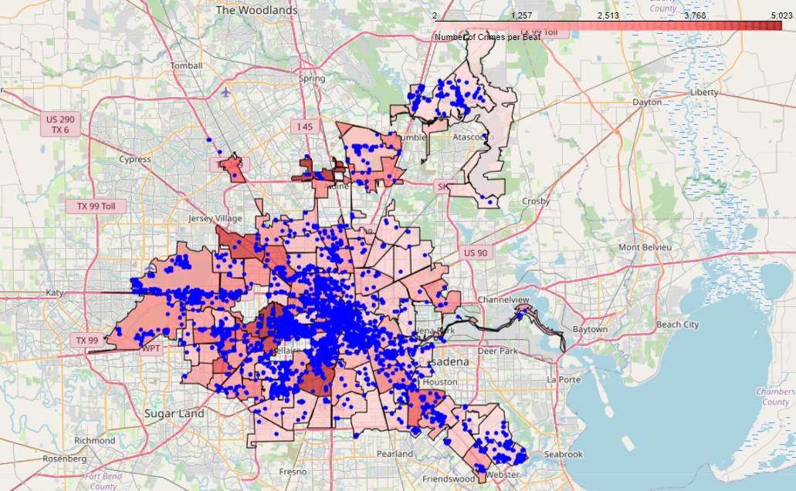
MAPPING PARKING LOTS ON THE BEATS
The data from the osmx is mapped on to the crime data.
The blue dots indicate the location of the parking lots and garages in the Houston city.
A clear view of the map can be found in the code.
The legend represents the distribution of crime over the beats.
Let us connect the crimes around the parkin

Slide 14
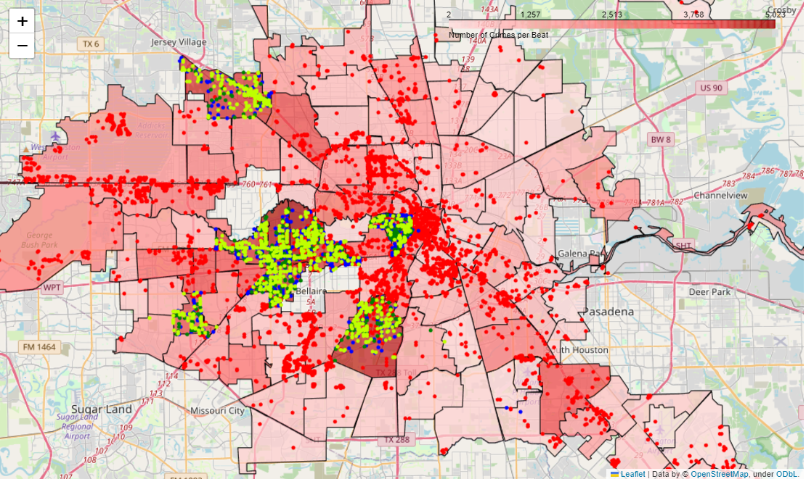
MAPPING OF CRIME AROUND THE PARKING ZONES
Mapping of the top 3 crimes
23F – Theft from motor vehicle ( )
240 – Motor vehicle theft ( )
23G – Theft from motor vehicle parts or accessory. ( )
The parking lots are marked as ( )
This visualization projects that the highest crime zone beats have theft of vehicle accessories and around the parking lots.
But when we zoom in, we observe that all these thefts are not in the parking zones.

Slide 15
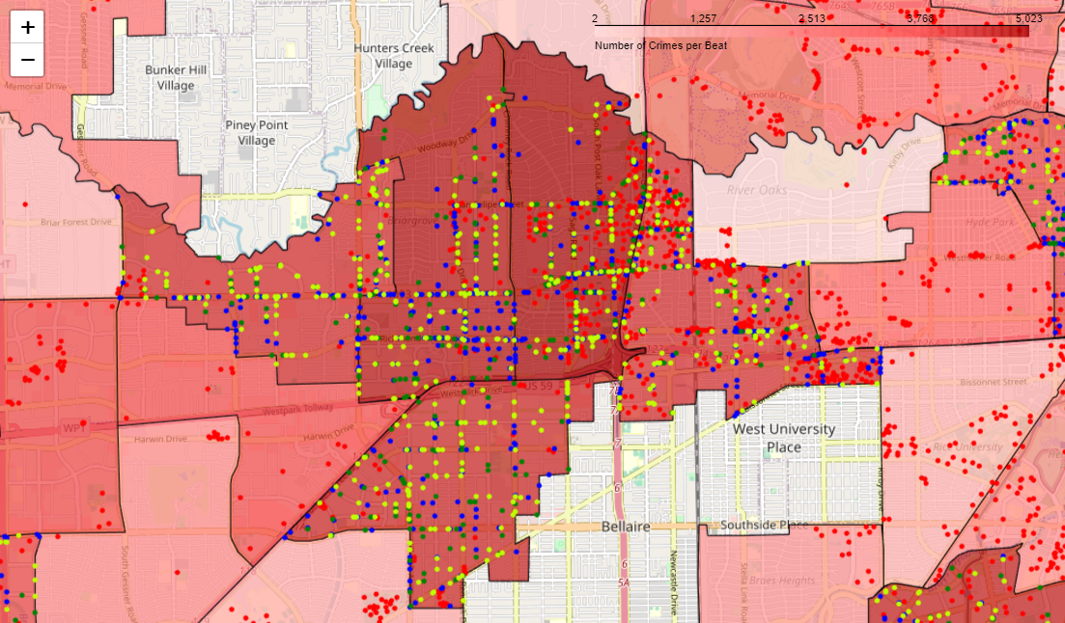
DETAILED VIEW OF THE CRIME ZONES
Considering 18F20, 18F30, 18F40 beats, we observe that the most of crime spots map onto the parking zones ( )
That is, the parking zones are not under good surveillance.
It is also observed that some points don’t fall under the parking zone due to ambiguity in the coordinates.

Slide 16
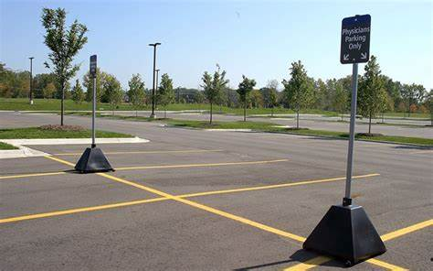
CONCLUSION
The scope of our project is vast but gives very useful analysis.
Mapping of the locations helps in geo spatial analysis and identifying patterns of crime in the various zones of the city.
Increased surveillance in parking zones can also lead to cost savings. For example, if a parking zone is experiencing a high rate of vehicle thefts, installing surveillance cameras may reduce the need for security personnel, saving the parking zone money in the long run.
The main benefits of our project includes as follows
Improved safety and security in parking lots
Improved traffic flow
Prevention of vandalism
Enhanced emergency response
Real time monitoring

Slide 17
FUTURE SCOPE
Further analysis, such as clustering techniques, can help identify groups of beats or areas with similar crime patterns and can inform the development of targeted law enforcement strategies.
The scope of the project can be extended to other amenities such as restaurants, bus tops, highways etc.
Geo spatial analysis offers wide range of decision making, increases efficiency, improves decision making, and crime management.
Crime analysis helps in deeper investigation, resource allocation and enhances public safety.

